Slide 1


Case Study Presentation
Acadia - Senior Consumer Data Analyst Candidate Next Steps- Gabriel Gregório
Data manipulation (ETL and CTE)
Analysis of the provided data
Campaign responses and insights

Slide 2

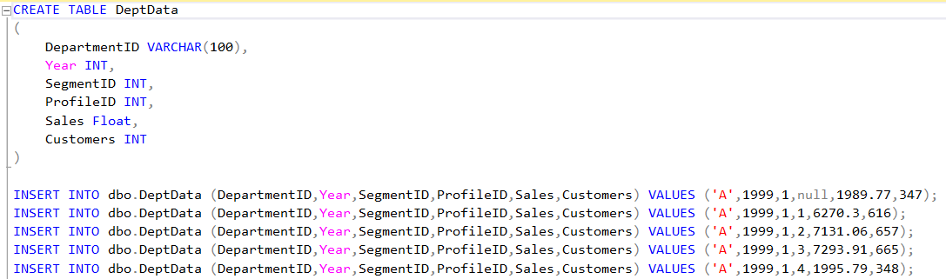
Data manipulation (ETL and CTE)
Step 1
Import the files into the Microsoft SQL Server Management Studio program.
Example:

Slide 3
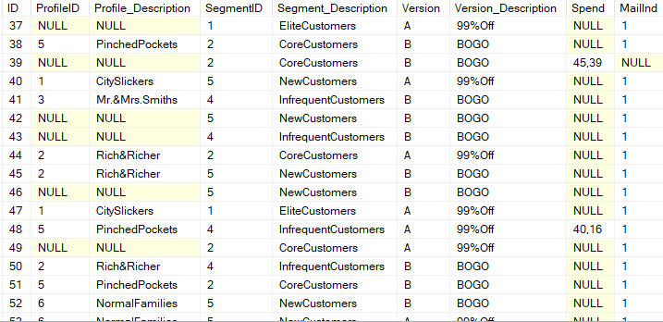
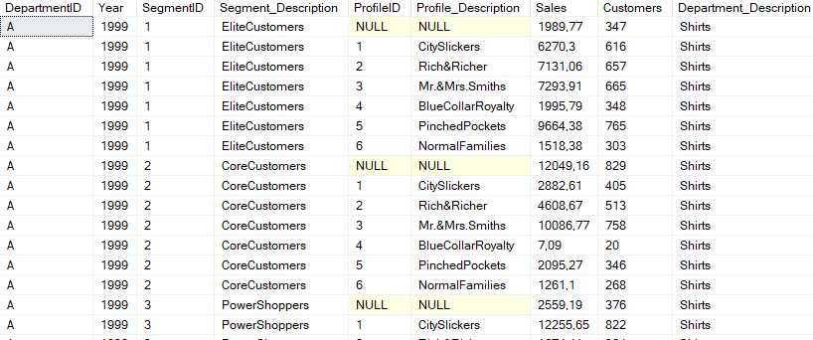
Data manipulation (ETL and CTE)
Step 2
Merging the datasets to analyze the data.
Campaign performance
Departmental sales
select
CO.ID,
CO.ProfileID,
PR.Profile_Description,
CO.SegmentID,
SE.Segment_Description,
VE.Version,
IV.Version_Description,
SA.Spend,
VE.MailInd
from costumers CO
left join Sales SA on SA.ID=CO.ID
left join versions VE on VE.ID=CO.ID
left join Segments SE on SE.SegmentID =CO.SegmentID
left join Profiles PR on PR.ProfileID=CO.ProfileID
left join InfoVersions IV on IV.version=VE.Version
select
DD.DepartmentID,
DD.Year,
DD.SegmentID,
SE.Segment_Description,
DD.ProfileID,
PR.Profile_Description,
DD.Sales,
DD.Customers,
DE.Department_Description
from DeptData DD
left join Departments DE on DE.DepartmentID=DD.DepartmentID
left join Segments SE on SE.SegmentID =DD.SegmentID
left join Profiles PR on PR.ProfileID=DD.ProfileIDDepartmentID
Example:

Slide 4


Marketing campaign results
Section 1 -
Marketing Campaign

Slide 5


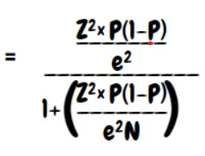
Overall, which version generated better incremental results?
N = sample size
Z = z-score
E = margin of error
P = standard deviation
Equation
N = 110,000
Z = 2,58
E = ??? (0,01282)
P = 0,5
Control=10.000
(99% confidence)
Based on the numbers presented from the control group, I estimate that the sampling precision error of the control sample is only 1.28% based on the equation presented.

Slide 6
Overall, which version generated better incremental results?
Convertion Rate
 | 99%OFF |  |  |  | BOGO
PROFILE | % Test | % Control | % Div |  | % Test | % Control | % Div
BlueCollarRoyalty | 8,86% | 11,07% | -2,21% |  | 8,98% | 8,79% | 0,19%
CitySlickers | 10,15% | 9,55% | 0,60% |  | 10,94% | 11,40% | -0,47%
Mr.&Mrs.Smiths | 2,69% | 2,18% | 0,52% |  | 3,05% | 3,44% | -0,39%
NormalFamilies | 9,33% | 8,16% | 1,17% |  | 9,13% | 8,33% | 0,80%
NULL | 5,94% | 5,35% | 0,59% |  | 6,48% | 6,54% | -0,07%
PinchedPockets | 7,56% | 7,54% | 0,02% |  | 8,40% | 7,37% | 1,03%
Rich&Richer | 10,35% | 10,29% | 0,06% |  | 11,14% | 9,28% | 1,86%
Total | 7,27% | 7,03% | 0,24% |  | 7,76% | 7,40% | 0,36%
 | 99%OFF |  |  |  | BOGO
PROFILE | % Test | % Control | % Div |  | % Test | % Control | % Div
CoreCustomers | 8,24% | 8,05% | 0,20% |  | 8,90% | 9,59% | -0,70%
EliteCustomers | 8,99% | 9,71% | -0,72% |  | 9,79% | 7,84% | 1,95%
InfrequentCustomers | 6,97% | 5,00% | 1,97% |  | 7,06% | 6,68% | 0,38%
NewCustomers | 5,78% | 5,22% | 0,56% |  | 6,71% | 5,92% | 0,79%
PowerShoppers | 7,84% | 8,10% | -0,26% |  | 8,47% | 7,96% | 0,51%
Total | 7,27% | 7,03% | 0,24% |  | 7,76% | 7,40% | 0,36%
Even though there is a margin of error of 1.28% in the comparison of the control group vs. the test group, we have a higher conversion rate in the action groups.

Slide 7
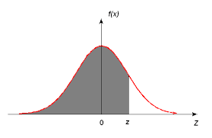
Z-test statistic
Despite having a positive difference between the conversion rates, we need to validate if it is significant!
Using the z-test to validate if the conversion difference is significant.

Slide 8
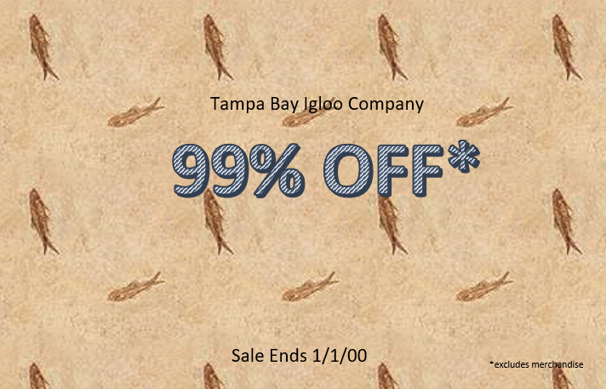
Is this percentage difference significant?
 | 99%OFF
 | Sum (ID Costumer) | Sum (ID Sales)
Test | 50141 | 3646
Control | 5080 | 357
Total Geral | 55221 | 4003
Establish the hypotheses:
Step 1:
Choose a significance level (alpha): Let's say you choose a significance level of 0.05 (or 5%)
Critical value for a two-tailed test is approximately ±1.96.
Step 2:
Calculate the proportions and combined proportion:
Proportion of group A: p1 = 3646/50.141 = 0.0727 (or 7.27%)
Proportion of group B: p2 = 357/5.080 = 0.0702 (or 7.02%)
Combined proportion: p = (p1 * n1 + p2 * n2) / (n1 + n2) p = (0.0727 * 50,141 + 0.0702 * 5080) / (50.141 + 5.080) = 0.0724 (or 7.24%).
Step 3:
Calculate the estimated standard deviation: Estimated standard deviation: sqrt(p * (1 - p) * (1/n1 + 1/n2)) Estimated standard deviation = sqrt(0.0724 * (1 - 0.0724) * (1/50,141 + 1/5080)) = 0.00381.
Step 4:
Calculate the Z-test statistic: Z-test statistic:
(p1 - p2) / estimated standard deviation Z-test statistic = (0.0724 - 0.0702) / 0.00381 = 0.5774
(Based solely on the provided value of -1.96< 0.5774 <1.96, we can conclude that the result would not be statistically significant, assuming a significance level of 0.05).

Slide 9
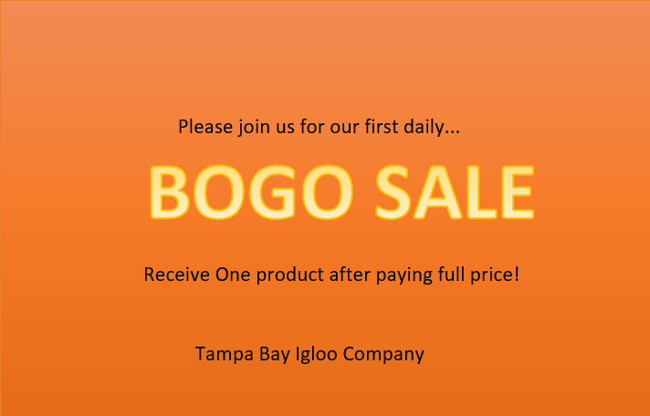
Is this percentage difference significant?
 | BOGO
 | Sum (ID Costumer) | Sum (ID Sales)
Test | 49859 | 3867
Control | 4920 | 364
Total Geral | 54779 | 4231
Establish the hypotheses:
Step 1:
Choose a significance level (alpha): Let's say you choose a significance level of 0.05 (or 5%).
Critical value for a two-tailed test is approximately ±1.96.
Step 2:
Calculate the proportions and combined proportion:
Proportion of group A: p1 = 3867/49.859 = 0.0775 (or 7.75%).
Proportion of group B: p2 = 364/4.920 = 0.07398 (or 7.398%)
Combined proportion: p = (p1 * n1 + p2 * n2) / (n1 + n2) p = (0.0775 * 49.859 + 0.07398 * 4.920) / (49.859 + 4.920) = 0.07499 (or 7.499%).
Step 3:
Calculate the estimated standard deviation: Estimated standard deviation: sqrt(p * (1 - p) * (1/n1 + 1/n2)) Estimated standard deviation = sqrt(0.07499 * (1 - 0.07499) * (1/49.859 + 1/4.920)) = 0.003936.
Step 4:
Calculate the Z-test statistic: Z-test statistic:
(p1 - p2) / estimated standard deviation Z-test statistic = (0.0775 - 0.07398) / 0.003936 = 0.8943
(Based solely on the provided value of -1,96< 0.8943 <1,96, we can conclude that the result would not be statistically significant, assuming a significance level of 0.05).

Slide 10
Did a particular version perform better for a particular set of customers? If so, what are the marketing implications of this result? If so, what are the marketing implications of this result?
Convertion Rate
For the 99%OFF campaign, the NormalFamilies
Profile had the highest conversion rate.
For the BOGO campaign, the Rich&Richer
Profile had the highest conversion rate.
For the 99%OFF campaign, the InfrequentCustomers
Profile had the highest conversion rate.
For the BOGO campaign, the EliteCustomers
Profile had the highest conversion rate.

Slide 11
What changes can be made to this marketing campaign in order to improve future results?
The 99%OFF campaign had
a greater impact on
lower-income consumers.
Versions
A very relevant idea would be to handle the design of the images more focused on the audience that had better performance
The BOGO campaign had a
greater impact on
higher-income consumers

Slide 12
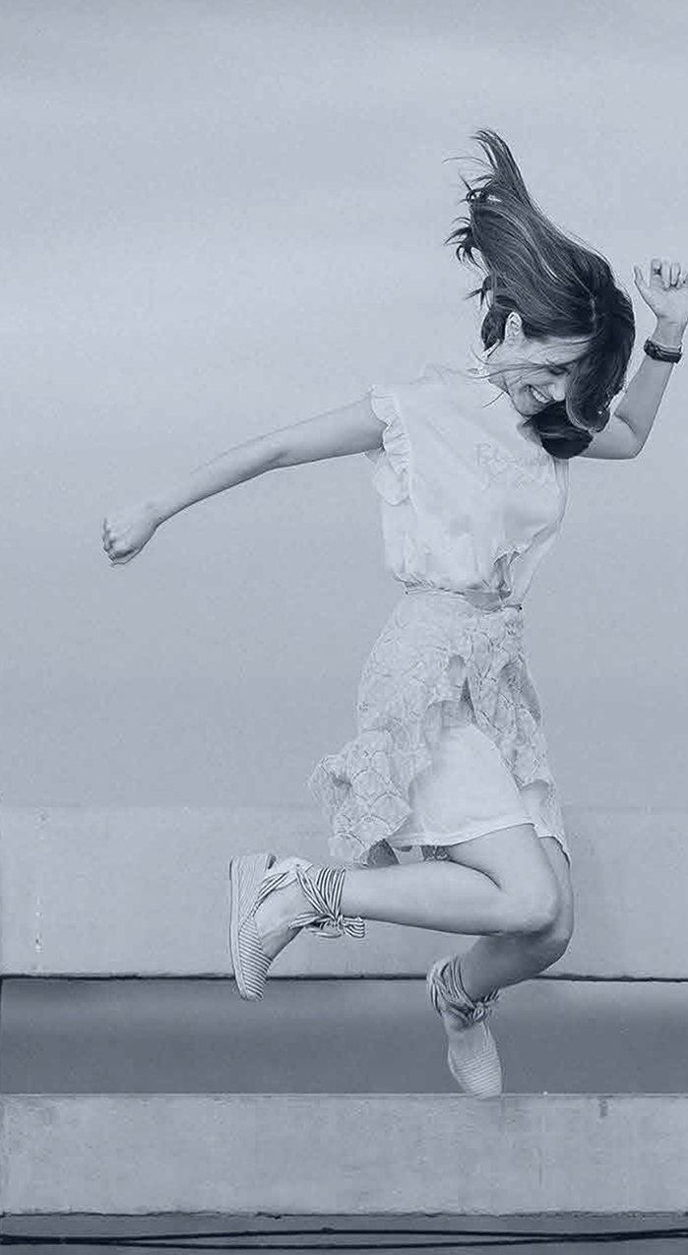
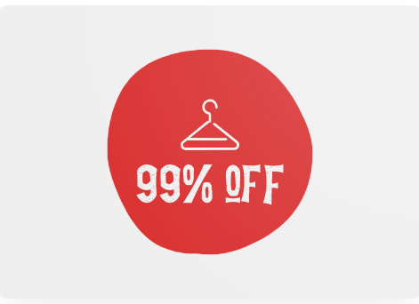
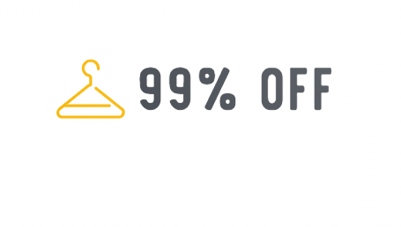
What changes can be made to this marketing campaign in order to improve future results?
When targeting a low-income audience in marketing campaigns, choose warm earth tones and soft orange, yellow and red. These colors convey affordability and comfort. Additionally, select a simple and readable font to ensure clarity in communication and ease of understanding. Make sure to demonstrate cultural sensitivity and align with the brand message to effectively engage the low-income demographic..

Slide 13
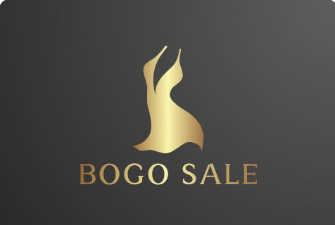
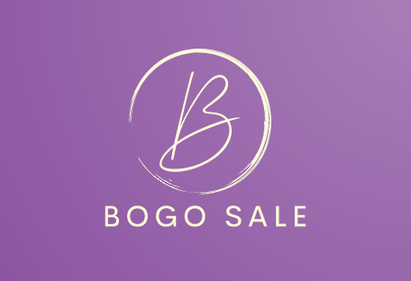
What changes can be made to this marketing campaign in order to improve future results?
When targeting high-ticket buyers in marketing campaigns, opt for sophisticated and luxurious colors such as deep blues, rich purples, black and elegant metallic tones. These colors convey exclusivity and quality. Additionally, use sleek and modern fonts to reflect a high-end image and create a sense of refinement. Ensure consistent branding and messaging to effectively resonate with the high-ticket buyer demographic

Slide 14


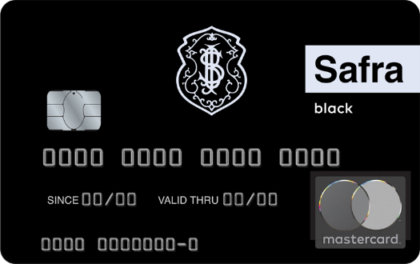







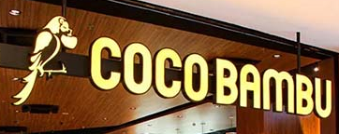

What changes can be made to this marketing campaign in order to improve future results?
Retail Banks x High-end banks
Cheap Cloting brands x Luxury clothing brand
Affordable foods x Expensive food

Slide 15


Year-over-year performance
Section 2 -
Department Year over Year

Slide 16
Overall, which Department is showing the most growth from year to year?
Results
DEPARTMENT | 1999 | 2000 | Total Geral | % Dif |  | DEPARTMENT | 1999 | 2000 | Total Geral | % Dif
Beachwear | 51046 | 48052 | 99098 | 94,13% |  | Beachwear | R$ 356.220,97 | R$ 339.984,00 | R$ 696.204,97 | 95,4%
BootAccessories | 18979 | 19201 | 38180 | 101,17% |  | BootAccessories | R$ 70.552,21 | R$ 77.917,26 | R$ 148.469,47 | 110,4%
Boots | 97 | 87598 | 87695 | 90307,22% |  | Boots | R$ 0,20 | R$ 221.195,93 | R$ 221.196,13 | 110597965,0%
CowboyHats | 81032 | 78811 | 159843 | 97,26% |  | CowboyHats | R$ 976.847,52 | R$ 981.209,97 | R$ 1.958.057,49 | 100,4%
Formalwear | 86295 | 81335 | 167630 | 94,25% |  | Formalwear | R$ 152.392,20 | R$ 143.196,63 | R$ 295.588,83 | 94,0%
KnickKnacks | 100833 | 89 | 100922 | 0,09% |  | KnickKnacks | R$ 4.839.808,64 | R$ 4,10 | R$ 4.839.812,74 | 0,0%
Misc | 80777 | 72243 | 153020 | 89,44% |  | Misc | R$ 451.348,19 | R$ 385.467,78 | R$ 836.815,97 | 85,4%
Shirts | 14998 | 14967 | 29965 | 99,79% |  | Shirts | R$ 159.296,30 | R$ 167.968,24 | R$ 327.264,54 | 105,4%
StoreUse | 28767 | 28245 | 57012 | 98,19% |  | StoreUse | R$ 35.231,94 | R$ 36.025,56 | R$ 71.257,50 | 102,3%
WomensJeans | 23453 | 20931 | 44384 | 89,25% |  | WomensJeans | R$ 422.703,67 | R$ 361.140,74 | R$ 783.844,41 | 85,4%
Total Geral | 486277 | 451472 | 937749 | 92,84% |  | Total Geral | R$ 7.464.401,84 | R$ 2.714.110,21 | R$ 10.178.512,05 | 36%
Boots is the new department that grew significantly in 2000 compared to 1999.
But the KnickKnacks Department ceased its operations, and this exit greatly affected the company.

Slide 17
Are there any particular groups of customers that are showing notable shifts in their purchasing habits from year to year? If so, what are the marketing implications of these shifts?
Results
PROFILE | 1999 | 2000 | Total Geral | % #Dif |  | PROFILE | 1999 | 2000 | Total Geral | % $Dif
BlueCollarRoyalty | 56206 | 52228 | 108434 | 92,9% |  | BlueCollarRoyalty | R$ 888.311,64 | R$ 314.778,90 | R$ 1.203.090,54 | 35,4%
CitySlickers | 98364 | 91731 | 190095 | 93,3% |  | CitySlickers | R$ 1.670.574,66 | R$ 592.707,48 | R$ 2.263.282,14 | 35,5%
Mr.&Mrs.Smiths | 88728 | 83005 | 171733 | 93,5% |  | Mr.&Mrs.Smiths | R$ 1.524.126,97 | R$ 579.201,62 | R$ 2.103.328,59 | 38,0%
NormalFamilies | 31051 | 28288 | 59339 | 91,1% |  | NormalFamilies | R$ 200.379,05 | R$ 68.016,36 | R$ 268.395,41 | 33,9%
NULL | 88122 | 82908 | 171030 | 94,1% |  | NULL | R$ 1.422.741,35 | R$ 516.249,21 | R$ 1.938.990,56 | 36,3%
PinchedPockets | 50210 | 44712 | 94922 | 89,0% |  | PinchedPockets | R$ 725.431,87 | R$ 246.091,89 | R$ 971.523,76 | 33,9%
Rich&Richer | 73596 | 68600 | 142196 | 93,2% |  | Rich&Richer | R$ 1.032.836,30 | R$ 397.064,75 | R$ 1.429.901,05 | 38,4%
Total Geral | 486277 | 451472 | 937749 | 92,8% |  | Total Geral | R$ 7.464.401,84 | R$ 2.714.110,21 | R$ 10.178.512,05 | 36,4%
The new Boots department and the closed KnickKnacks department had a homogeneous distribution across all profiles, indicating that neither had a relatively more pronounced variation than the other..

Slide 18
Are there any particular groups of customers that are showing notable shifts in their purchasing habits from year to year? If so, what are the marketing implications of these shifts?
Results
KnickKnacks
SEGMENT | 1999 | 2000 | Total Geral |  | SEGMENT | 1999 | 2000 | Total Geral
CoreCustomers | 22958 | 20 | 22978 |  | CoreCustomers | R$ 1.198.962,96 | R$ 0,91 | R$ 1.198.963,87
EliteCustomers | 26456 | 23 | 26479 |  | EliteCustomers | R$ 1.243.867,85 | R$ 1,13 | R$ 1.243.868,98
InfrequentCustomers | 17027 | 14 | 17041 |  | InfrequentCustomers | R$ 761.115,77 | R$ 0,63 | R$ 761.116,40
NewCustomers | 16400 | 16 | 16416 |  | NewCustomers | R$ 827.291,13 | R$ 0,80 | R$ 827.291,93
PowerShoppers | 17992 | 16 | 18008 |  | PowerShoppers | R$ 808.570,93 | R$ 0,63 | R$ 808.571,56
Total Geral | 100833 | 89 | 100922 |  | Total Geral | R$ 4.839.808,64 | R$ 4,10 | R$ 4.839.812,74
BOOTS
SEGMENT | 1999 | 2000 | Total Geral |  | SEGMENT | 1999 | 2000 | Total Geral
CoreCustomers | 19 | 17214 | 17233 |  | CoreCustomers | R$ 0,04 | R$ 37.001,55 | R$ 37.001,59
EliteCustomers | 29 | 22749 | 22778 |  | EliteCustomers | R$ 0,05 | R$ 68.673,47 | R$ 68.673,52
InfrequentCustomers | 19 | 17240 | 17259 |  | InfrequentCustomers | R$ 0,05 | R$ 45.260,48 | R$ 45.260,53
NewCustomers | 14 | 15439 | 15453 |  | NewCustomers | R$ 0,03 | R$ 40.536,53 | R$ 40.536,56
PowerShoppers | 16 | 14956 | 14972 |  | PowerShoppers | R$ 0,03 | R$ 29.723,90 | R$ 29.723,93
Total Geral | 97 | 87598 | 87695 |  | Total Geral | R$ 0,20 | R$ 221.195,93 | R$ 221.196,13

Slide 19
Are there any particular groups of customers that are showing notable shifts in their purchasing habits from year to year? If so, what are the marketing implications of these shifts?
Results
KnickKnacks
PROFILE | 1999 | 2000 | Total Geral |  | PROFILE | 1999 | 2000 | Total Geral
BlueCollarRoyalty | 11820 | 10 | 11830 |  | BlueCollarRoyalty | R$ 572.283,41 | R$ 0,46 | R$ 572.283,87
CitySlickers | 20449 | 19 | 20468 |  | CitySlickers | R$ 1.086.229,44 | R$ 0,91 | R$ 1.086.230,35
Mr.&Mrs.Smiths | 18000 | 17 | 18017 |  | Mr.&Mrs.Smiths | R$ 975.041,83 | R$ 0,85 | R$ 975.042,68
NormalFamilies | 6547 | 5 | 6552 |  | NormalFamilies | R$ 133.447,65 | R$ 0,11 | R$ 133.447,76
NULL | 18023 | 15 | 18038 |  | NULL | R$ 920.206,77 | R$ 0,76 | R$ 920.207,53
PinchedPockets | 10936 | 9 | 10945 |  | PinchedPockets | R$ 491.395,07 | R$ 0,42 | R$ 491.395,49
Rich&Richer | 15058 | 14 | 15072 |  | Rich&Richer | R$ 661.204,47 | R$ 0,59 | R$ 661.205,06
Total Geral | 100833 | 89 | 100922 |  | Total Geral | R$ 4.839.808,64 | R$ 4,10 | R$ 4.839.812,74
BOOTS
PROFILE | 1999 | 2000 | Total Geral |  | PROFILE | 1999 | 2000 | Total Geral
BlueCollarRoyalty | 12 | 10774 | 10786 |  | BlueCollarRoyalty | R$ 0,03 | R$ 28.753,20 | R$ 28.753,23
CitySlickers | 20 | 18072 | 18092 |  | CitySlickers | R$ 0,05 | R$ 51.299,62 | R$ 51.299,67
Mr.&Mrs.Smiths | 17 | 15569 | 15586 |  | Mr.&Mrs.Smiths | R$ 0,03 | R$ 43.236,66 | R$ 43.236,69
NormalFamilies | 6 | 5676 | 5682 |  | NormalFamilies | R$ - | R$ 6.325,54 | R$ 6.325,54
NULL | 17 | 15504 | 15521 |  | NULL | R$ 0,04 | R$ 37.414,88 | R$ 37.414,92
PinchedPockets | 10 | 9099 | 9109 |  | PinchedPockets | R$ 0,02 | R$ 23.817,83 | R$ 23.817,85
Rich&Richer | 15 | 12904 | 12919 |  | Rich&Richer | R$ 0,03 | R$ 30.348,20 | R$ 30.348,23
Total Geral | 97 | 87598 | 87695 |  | Total Geral | R$ 0,20 | R$ 221.195,93 | R$ 221.196,13

Slide 20
Based on this data, what marketing efforts or strategies will reinforce positive trends or mitigate negative trends to grow future sales?
Results
 |  |  |  |  |  |  |  |  | Average Ticket
Profile | 1999 | 2000 | Total Geral |  | 1999 | 2000 | Total Geral |  | 1999 | 2000 | Total Geral
Rich&Richer | 73596 | 68600 | 142196 |  | R$ 1.032.836,30 | R$ 397.064,75 | R$ 1.429.901,05 |  | R$ 14,03 | R$ 5,79 | R$ 10,06
BlueCollarRoyalty | 56206 | 52228 | 108434 |  | R$ 888.311,64 | R$ 314.778,90 | R$ 1.203.090,54 |  | R$ 15,80 | R$ 6,03 | R$ 11,10
CitySlickers | 98364 | 91731 | 190095 |  | R$ 1.670.574,66 | R$ 592.707,48 | R$ 2.263.282,14 |  | R$ 16,98 | R$ 6,46 | R$ 11,91
Mr.&Mrs.Smiths | 88728 | 83005 | 171733 |  | R$ 1.524.126,97 | R$ 579.201,62 | R$ 2.103.328,59 |  | R$ 17,18 | R$ 6,98 | R$ 12,25
NormalFamilies | 31051 | 28288 | 59339 |  | R$ 200.379,05 | R$ 68.016,36 | R$ 268.395,41 |  | R$ 6,45 | R$ 2,40 | R$ 4,52
PinchedPockets | 50210 | 44712 | 94922 |  | R$ 725.431,87 | R$ 246.091,89 | R$ 971.523,76 |  | R$ 14,45 | R$ 5,50 | R$ 10,23
NULL | 88122 | 82908 | 171030 |  | R$ 1.422.741,35 | R$ 516.249,21 | R$ 1.938.990,56 |  | R$ 16,15 | R$ 6,23 | R$ 11,34
Total Geral | R$ 486.277,00 | R$ 451.472,00 | R$ 937.749,00 |  | R$ 7.464.401,84 | R$ 2.714.110,21 | R$ 10.178.512,05 |  | R$ 15,35 | R$ 6,01 | R$ 10,85
The sales volume didn't decrease much from 1999 to 2000, the problem with the 64% revenue loss lies in the drastic decrease of the average ticket from $15.35 to $6.01.

Slide 21
Based on this data, what marketing efforts or strategies will reinforce positive trends or mitigate negative trends to grow future sales?
Results
Average Ticket
DEPARTMENT | 1999 | 2000 | Total Geral | % #Dif |  | 1999 | 2000 | Total Geral | % $Dif |  | 1999 | 2000 | Total Geral
Beachwear | 51046 | 48052 | 99098 | 94,13% |  | R$ 356.220,97 | R$ 339.984,00 | R$ 696.204,97 | 95,4% |  | R$ 6,98 | R$ 7,08 | R$ 7,03
BootAccessories | 18979 | 19201 | 38180 | 101,17% |  | R$ 70.552,21 | R$ 77.917,26 | R$ 148.469,47 | 110,4% |  | R$ 3,72 | R$ 4,06 | R$ 3,89
Boots | 97 | 87598 | 87695 | 90307,22% |  | R$ 0,20 | R$ 221.195,93 | R$ 221.196,13 | 110597965,0% |  | R$ 0,00 | R$ 2,53 | R$ 2,52
CowboyHats | 81032 | 78811 | 159843 | 97,26% |  | R$ 976.847,52 | R$ 981.209,97 | R$ 1.958.057,49 | 100,4% |  | R$ 12,06 | R$ 12,45 | R$ 12,25
Formalwear | 86295 | 81335 | 167630 | 94,25% |  | R$ 152.392,20 | R$ 143.196,63 | R$ 295.588,83 | 94,0% |  | R$ 1,77 | R$ 1,76 | R$ 1,76
KnickKnacks | 100833 | 89 | 100922 | 0,09% |  | R$ 4.839.808,64 | R$ 4,10 | R$ 4.839.812,74 | 0,0% |  | R$ 48,00 | R$ 0,05 | R$ 47,96
Misc | 80777 | 72243 | 153020 | 89,44% |  | R$ 451.348,19 | R$ 385.467,78 | R$ 836.815,97 | 85,4% |  | R$ 5,59 | R$ 5,34 | R$ 5,47
Shirts | 14998 | 14967 | 29965 | 99,79% |  | R$ 159.296,30 | R$ 167.968,24 | R$ 327.264,54 | 105,4% |  | R$ 10,62 | R$ 11,22 | R$ 10,92
StoreUse | 28767 | 28245 | 57012 | 98,19% |  | R$ 35.231,94 | R$ 36.025,56 | R$ 71.257,50 | 102,3% |  | R$ 1,22 | R$ 1,28 | R$ 1,25
WomensJeans | 23453 | 20931 | 44384 | 89,25% |  | R$ 422.703,67 | R$ 361.140,74 | R$ 783.844,41 | 85,4% |  | R$ 18,02 | R$ 17,25 | R$ 17,66
Total Geral | 486277 | 451472 | 937749 | 92,84% |  | R$ 7.464.401,84 | R$ 2.714.110,21 | R$ 10.178.512,05 | 36% |  | R$ 15,35 | R$ 6,01 | R$ 10,85
This sharp drop in the average ticket originated from the closure of the KnickKnacks department, which had the highest average ticket, being replaced by the Boots department, which has a lower average ticket. As a result, even though the sales decline was only 7%, it severely impacted the earnings.

Slide 22
Based on this data, what marketing efforts or strategies will reinforce positive trends or mitigate negative trends to grow future sales?
Results
Average Ticket
DEPARTMENT | 1999 | 2000 | Total Geral | % #Dif |  | 1999 | 2000 | Total Geral | % $Dif |  | 1999 | 2000 | Total Geral
Beachwear | 51046 | 48052 | 99098 | 94,13% |  | R$ 356.220,97 | R$ 339.984,00 | R$ 696.204,97 | 95,4% |  | R$ 6,98 | R$ 7,08 | R$ 7,03
BootAccessories | 18979 | 19201 | 38180 | 101,17% |  | R$ 70.552,21 | R$ 77.917,26 | R$ 148.469,47 | 110,4% |  | R$ 3,72 | R$ 4,06 | R$ 3,89
Boots | 97 | 87598 | 87695 | 90307,22% |  | R$ 0,20 | R$ 221.195,93 | R$ 221.196,13 | 110597965,0% |  | R$ 0,00 | R$ 2,53 | R$ 2,52
CowboyHats | 81032 | 78811 | 159843 | 97,26% |  | R$ 976.847,52 | R$ 981.209,97 | R$ 1.958.057,49 | 100,4% |  | R$ 12,06 | R$ 12,45 | R$ 12,25
Formalwear | 86295 | 81335 | 167630 | 94,25% |  | R$ 152.392,20 | R$ 143.196,63 | R$ 295.588,83 | 94,0% |  | R$ 1,77 | R$ 1,76 | R$ 1,76
KnickKnacks | 100833 | 89 | 100922 | 0,09% |  | R$ 4.839.808,64 | R$ 4,10 | R$ 4.839.812,74 | 0,0% |  | R$ 48,00 | R$ 0,05 | R$ 47,96
Misc | 80777 | 72243 | 153020 | 89,44% |  | R$ 451.348,19 | R$ 385.467,78 | R$ 836.815,97 | 85,4% |  | R$ 5,59 | R$ 5,34 | R$ 5,47
Shirts | 14998 | 14967 | 29965 | 99,79% |  | R$ 159.296,30 | R$ 167.968,24 | R$ 327.264,54 | 105,4% |  | R$ 10,62 | R$ 11,22 | R$ 10,92
StoreUse | 28767 | 28245 | 57012 | 98,19% |  | R$ 35.231,94 | R$ 36.025,56 | R$ 71.257,50 | 102,3% |  | R$ 1,22 | R$ 1,28 | R$ 1,25
WomensJeans | 23453 | 20931 | 44384 | 89,25% |  | R$ 422.703,67 | R$ 361.140,74 | R$ 783.844,41 | 85,4% |  | R$ 18,02 | R$ 17,25 | R$ 17,66
Total Geral | 486277 | 451472 | 937749 | 92,84% |  | R$ 7.464.401,84 | R$ 2.714.110,21 | R$ 10.178.512,05 | 36% |  | R$ 15,35 | R$ 6,01 | R$ 10,85

Slide 23

Based on this data, what marketing efforts or strategies will reinforce positive trends or mitigate negative trends to grow future sales?
Results
 |  |  |  |  |  |  |  |  |  |  | Average Ticket
SEGMENT | 1999 | 2000 | Total Geral | % #Dif |  | 1999 | 2000 | Total Geral | % $Dif |  | 1999 | 2000 | Total Geral | % $Dif
CoreCustomers | 101420 | 89754 | 191174 | 88,5% |  | R$ 1.666.697,62 | R$ 422.767,83 | R$ 2.089.465,45 | 25,4% |  | R$ 16,43 | R$ 4,71 | R$ 10,93 | 29%
EliteCustomers | 123816 | 107324 | 231140 | 86,7% |  | R$ 1.869.370,18 | R$ 687.062,10 | R$ 2.556.432,28 | 36,8% |  | R$ 15,10 | R$ 6,40 | R$ 11,06 | 42%
InfrequentCustomers | 85789 | 81958 | 167747 | 95,5% |  | R$ 1.254.541,23 | R$ 493.638,32 | R$ 1.748.179,55 | 39,3% |  | R$ 14,62 | R$ 6,02 | R$ 10,42 | 41%
NewCustomers | 95234 | 97977 | 193211 | 102,9% |  | R$ 1.506.835,16 | R$ 769.917,62 | R$ 2.276.752,78 | 51,1% |  | R$ 15,82 | R$ 7,86 | R$ 11,78 | 50%
PowerShoppers | 80018 | 74459 | 154477 | 93,1% |  | R$ 1.166.957,65 | R$ 340.724,34 | R$ 1.507.681,99 | 29,2% |  | R$ 14,58 | R$ 4,58 | R$ 9,76 | 31%
Total Geral | 486277 | 451472 | 937749 | 92,8% |  | R$ 7.464.401,84 | R$ 2.714.110,21 | R$ 10.178.512,05 | 36,4% |  | R$ 15,35 | R$ 6,01 | R$ 10,85 | 39,2%
I would implement OrderBump practices for EliteCustomers, as they are our top-selling group with the second highest average ticket size. This would encourage them to spend more on each purchase.
I would continue investing in acquiring new leads because NewCustomers are currently our growing segment and have the highest average ticket size.
I would conduct an NPS (Net Promoter Score) campaign for CoreCustomers, with a survey at the end of the purchase and another one after delivery (or 7 days post-purchase for in-person transactions). In the second survey, I would use cross-selling marketing techniques to offer a second item that complements their previous purchase, along with a discount incentive to encourage repeat purchases. The satisfaction survey will provide valuable insights on how to better serve our core audience.

Slide 24
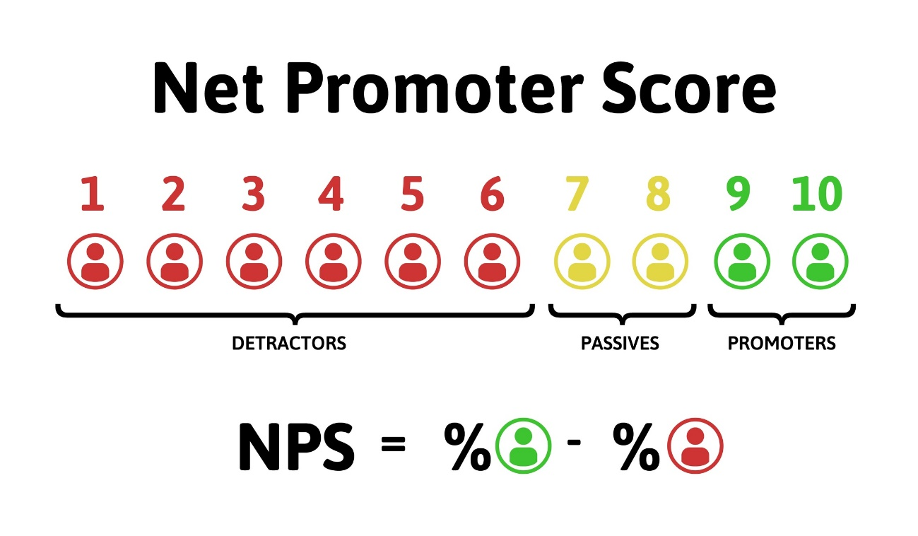


Based on this data, what marketing efforts or strategies will reinforce positive trends or mitigate negative trends to grow future sales?
Results
Product Experience
Customer Service
Shopping Experience
Delivery and Logistics:
Return Policy:
Price and Value:
Competition:
Communication and Marketing:
Additional Services:
Unmet Expectations:
Why are we losing
loyal customers?
If they don`t know us!
If they don`t buy with us!

Slide 25


Based on this data, what marketing efforts or strategies will reinforce positive trends or mitigate negative trends to grow future sales?
>
Bring new Costumers $$$
Sale to Frequent ones $
But if we don't know why our loyal customers are ceasing to make purchases,

Slide 26

I would invest in a recent marketing trend based on influencers for brand promotion and gaining acceptance within the community, creating desire for our products and increasing product awareness.
Influencers

Slide 27
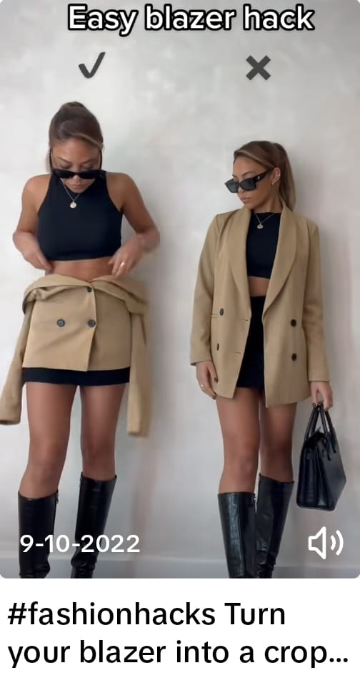
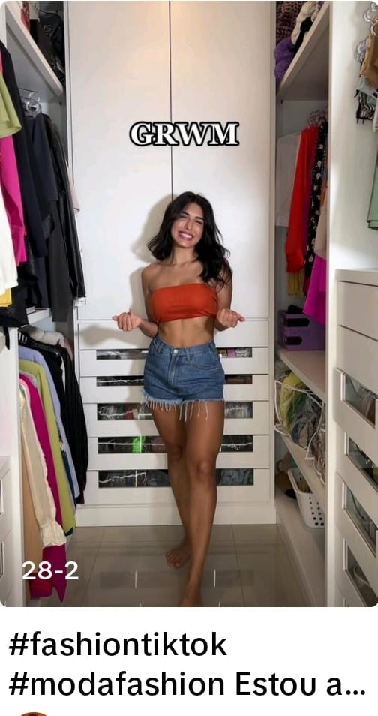

INFLUENCERS
Combining clothes in the right way
Get Ready
With Me
Trends like showcasing how to better mix and match clothing pieces would be a great success to invest in cross-selling marketing for our community of customers who may not yet have all the pieces to complete their ensemble.
Meanwhile, trends like GRWM (Get Ready With Me) would assist in generating new sales by demonstrating how to create appealing looks that would attract new customers and introduce them to our products

Slide 28

Thank you very much for making it this far!
I am open to questions or to present this material.

Slide 29

Senior Consumer Data Analyst Candidate
Thank you
Gabriel Gregório

Slide 30
Just one question about the material?
Negative valors in sales
Valors | Volume
(-800 to -700) | 1
(-700 to -600) | 1
(-600 to -500) | 3
(-500 to -400) | 7
(-400 to -300) | 10
(-300 to -200) | 50
(-200 to -100) | 137
(-100 to 0) | 199
0 to 100 | 4140
100 to 200 | 2461
200 to 300 | 765
300 to 400 | 246
400 to 500 | 126
500 to 600 | 49
600 to 700 | 21
700 to 800 | 7
900< | 11
Why do we have negative values in sales?
Returns or order cancellations: When a customer returns a product or cancels an order, the corresponding sale value can become negative?
Refunds: When a company issues a full or partial refund to a customer, the original sale value can be negated to reflect the refunded amount?
Discounts or promotions: If a sale involves significant discounts or promotions, the final sale value can become negative? Recording or accounting errors: Sometimes, errors can occur during the recording or accounting of sales, resulting in accidentally negative values. It is important to analyze and investigate further to identify the specific cause of negative values in sales within a specific context?

